Slide 1
Dataslices
Online & Offline Digital Media Marketing Company

Slide 2
Whatsapp broadcasting

Slide 3
Content
WhatsApp Broadcast
WhatsApp for Targeted Market
WhatsApp Broadcast – Dataslices Platform
Features
Demo
Sample Report

Slide 4
Whatsapp broadcast
WhatsApp Messenger is a cross-platform mobile messaging app which allows you to exchange messages without having to pay for SMS. WhatsApp Messenger is available for iPhone, BlackBerry, Android, Windows Phone and Nokia

Slide 5
Whatsapp FOR TARGETED MARKET
Dataslices WhatsApp marketing is an easy, affordable, and effective online marketing tactics that lets you build relationships with your customers, members, and prospects through personalized, relevant WhatsApp communications. By sending personalized, relevant WhatsApp’s you’ll increase sales, and improve your return on investment. WhatsApp marketing is the best way to attract interest in, build desire for, and generate sales of your products and services.

Slide 6
Whatsapp DATABASE FILTER
Filters:
Age
Gender
Nationality
Monthly income
Location
Psychographic/ Hobbies

Slide 7
Whatsapp broadcast – Dataslices platform
We can send your ad campaign on unlimited contacts in very short amount of time.
In your campaign you can send
Pictures.
Pamphlet/Brochures.
Audio and Videos to everyone.
We can set profile picture as your brand/company logo.
To unsubscribe a link will be there, to block that promotion message in future, this helps in anti-spamming.

Slide 8
Features
Whatsapp marketing Specifications:
Filter for Database | Geographic, Age, Gender, Income, Ethnicity, Psychographic
Sender id image | 350* 350 pixels
Message length | No limit
Message content | Text, Image, Audio and Video
Message features | Unsubscribe

Slide 9
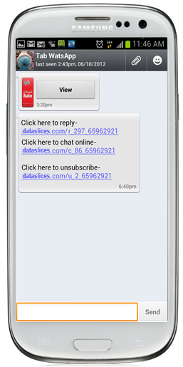
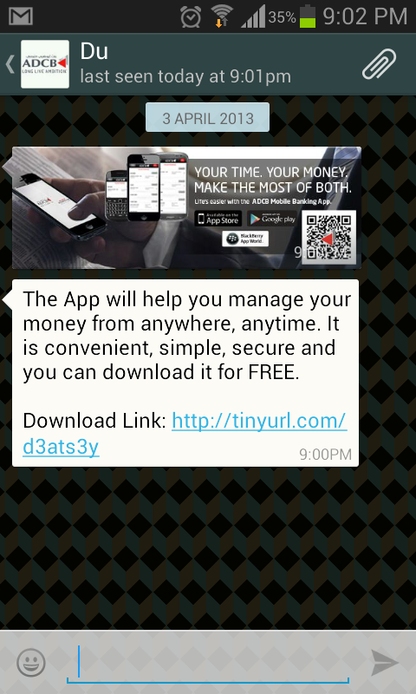
Demo
Brand logo
Brochure
Text

Slide 10
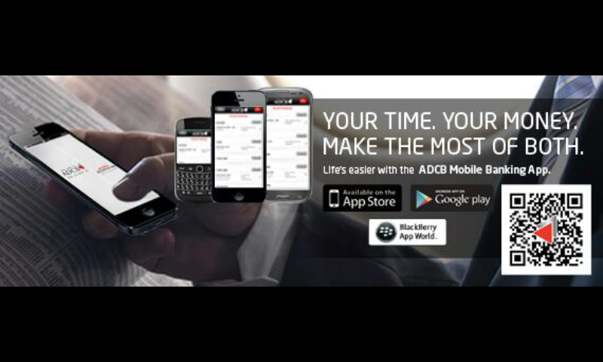
Demo
Clicking on image

Slide 11
Sample Report

Slide 12
Sample Report

Slide 13
Agency Partners

Slide 14
OUR CLIENTS

Slide 15
Thanks
Any questions?
You can find us at:
E-Mail: info@dataslices.com
Tel: +971 4 450 4292
Address: G 05, Loft Office 1, Media City, Dubai, UAE
Web: www.dataslices.com

Slide 16
THANK YOU

