Slide 1
Email Broadcast
SIGNING UP is a powerful signal of intent to BUY.
Send them email until they do.
By: Jordie van Rijn

Slide 2
DataSlices
is an online media marketing company based in Dubai Media City, UAE. For more than a decade, it has been providing online and digital media services to some of the world’s most successful brands. Owning over 32 million data records in the GCC region.
View our Client Portfolio: https://dataslices.com/clientlist/

Slide 3
Bulk Email Marketing Campaigns
Forms of Email Broadcast
1
2
Profiled Email Marketing Campaigns

Slide 4
Bulk Email Marketing
1
Campaigns

Slide 5
Bulk Email Marketing
Dataslices email marketing is an easy, affordable, and effective online marketing approach that let you build relationships with your customers, members, and prospects through personalized, relevant email communications. By sending personalized, relevant emails you’ll increase sales, and improve your return on investment.
Email marketing is the best way to attract interest in, build desire for, and generate sales of your products and services.

Slide 6
Bulk Email Marketing
Bulk Email Marketing
Email would be send as bulk to the desired city
No profiling
No tracking code
Inbox landing percentage 60-70%
Report will be given at the end of the campaign.

Slide 7
2
Profiled Email Marketing
Campaigns

Slide 8
Profiled Email Marketing
HTML creation
Newsletter will be converted into HTML.
Profiled Database
With profiled database you can target your desired audience, according to their age, nationality, occupation, location and psychographic.
Inbox percentage
80% of emails will land in inbox.
Tracking code
Advanced version.

Slide 9
Business to Consumer (B2C) database filtration
Profiled Email Marketing
ETHNICITY
RELIGION
INCOME
MARTIAL STATUS
HOME/CAR OWNERS
GEO LOCATION
AGE
GENDER

Slide 10
Business to Business (B2B) database filtration
Profiled Email Marketing
EDUCATION
SMALL BUSINESS OWNERS
PROFESSIONALS
Big Businesses

Slide 11
Report Deliverables
Sent Quantity
Failed Quantity
Delivered Quantity
Open Rate
Click Rate

Slide 12
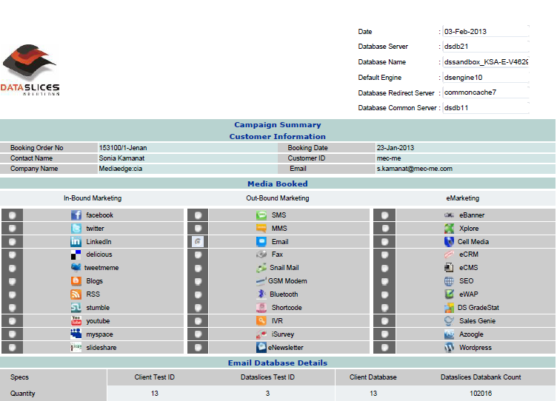
Report Sample – Part 1

Slide 13
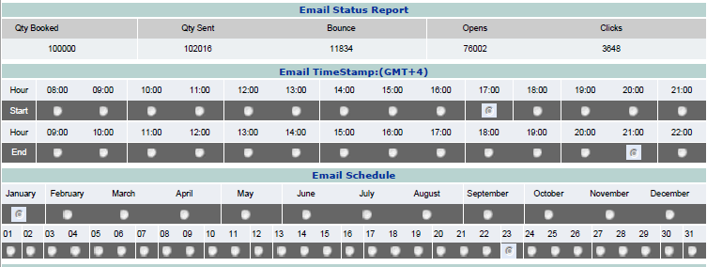
Report Sample – Part 2

Slide 14
Email Specs & Requirement
Text or Image
Standard image formats
Width = 600 pixels
height as required (up to 1,700 pixels)
From Name up to 35 characters
Subject line up to 65 characters

Slide 15
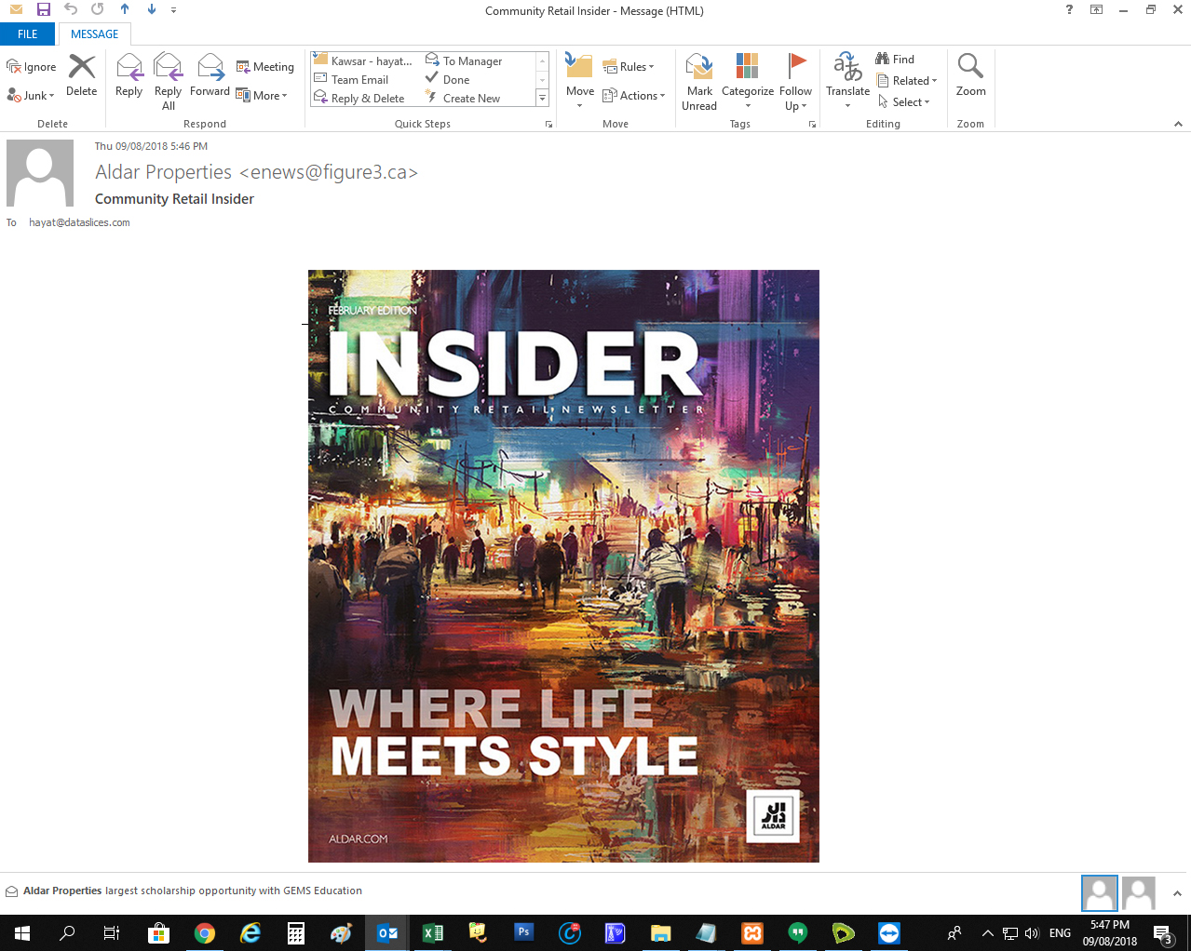
Desktop View

Slide 16
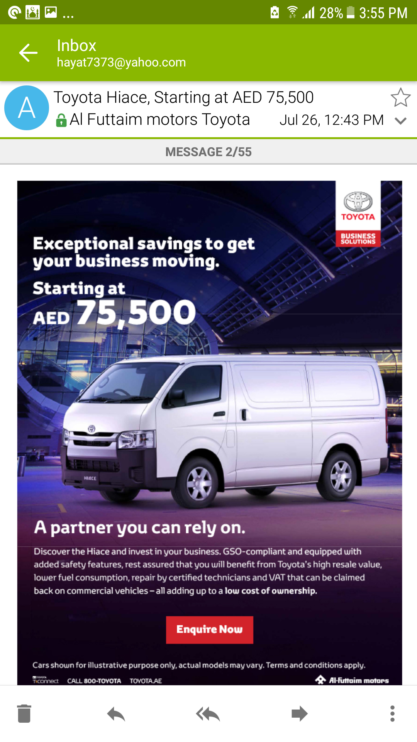
Mobile View

Slide 17
Agency Partners

Slide 18
Our Clients

Slide 19
Thanks!
Any questions?
You can find us at:
E-Mail: info@dataslices.com
Tel: +971 4 450 4292
Address: G 05, Loft Office 1, Media City, Dubai, UAE
Web: www.dataslices.com

